Slide 1
High Level MultiAgent Architecture

Slide 2
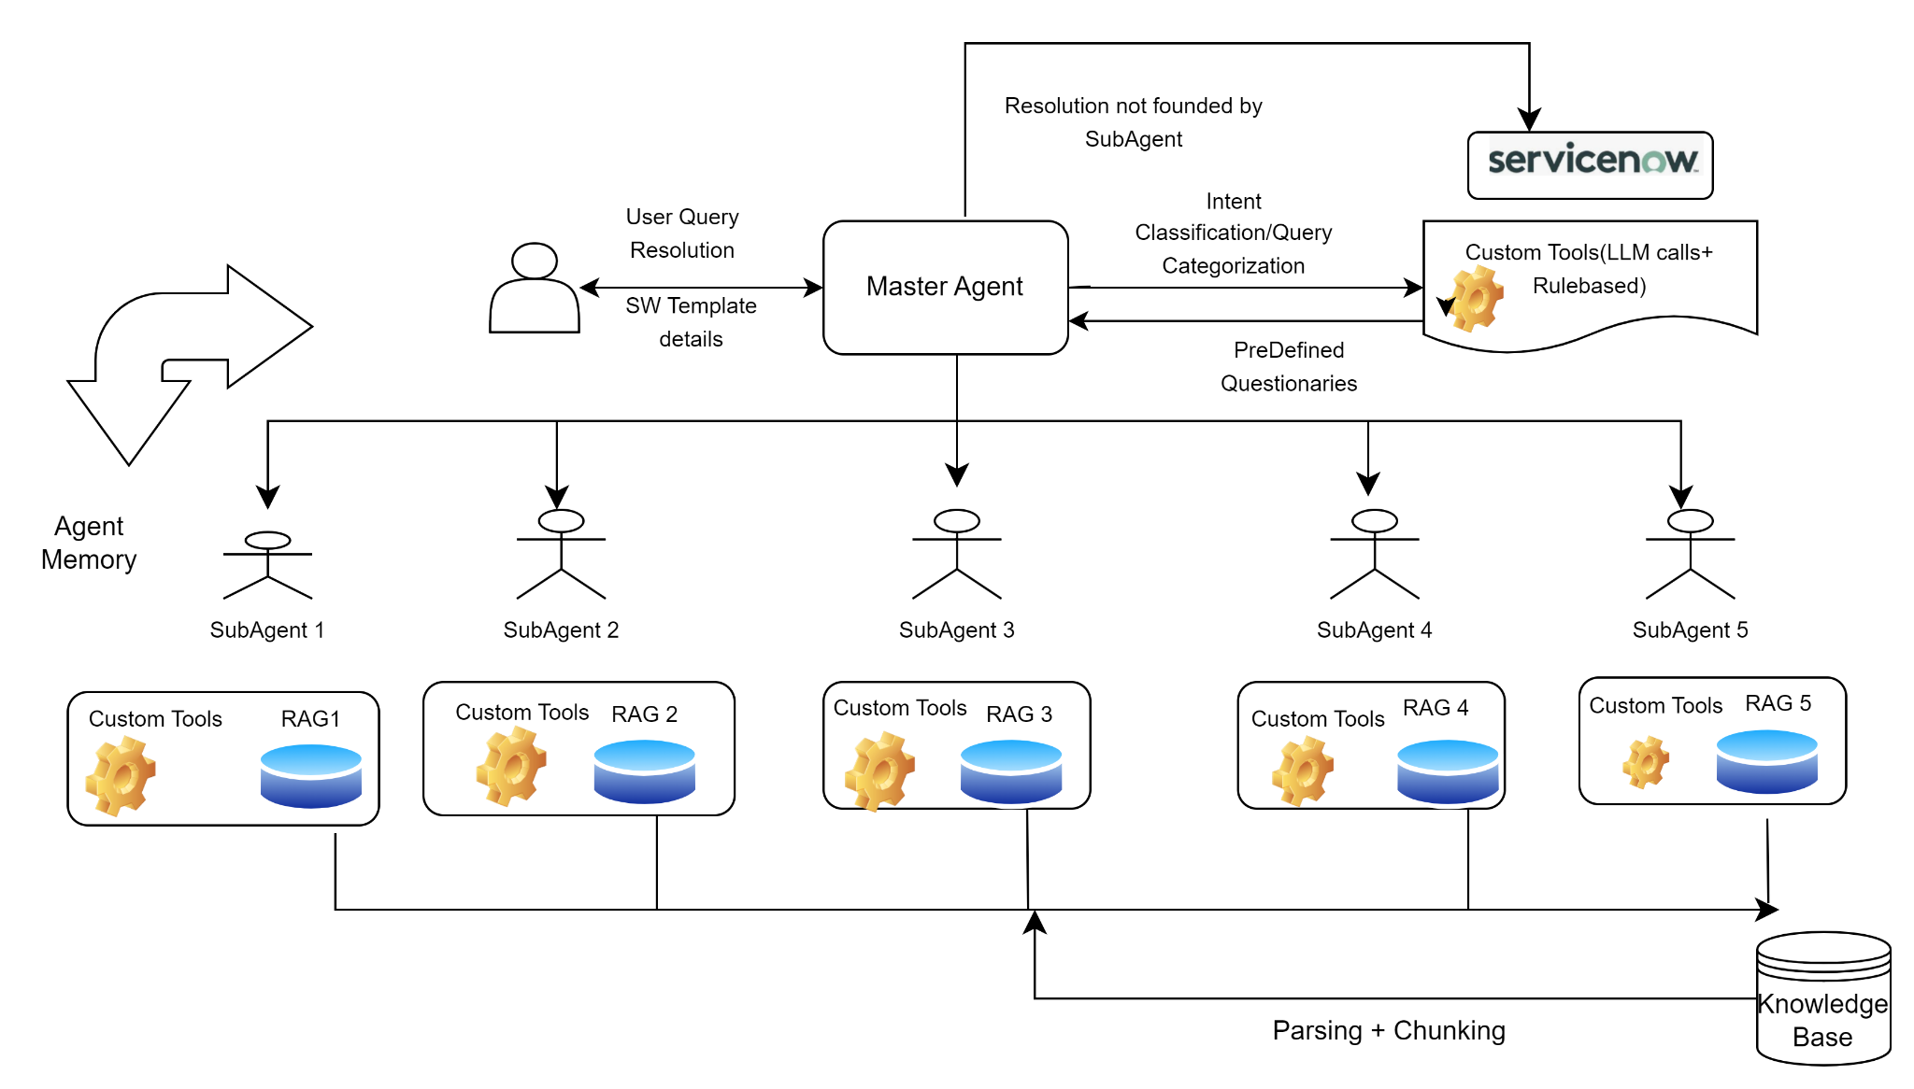
LangGraph

Slide 3
MultiAgent Tools
Pyhton
Langchain(along Dependencies)
LangGraph(along dependencies)
LangSmith
AzureCognitiveSerach(based on performance and accuracy Other Rag options like Chroma/Milvus)
AzureOpenAI(Ada Embeddings ,GPT)

Slide 4
Challenges
Multi Agent Memory Management

